Slide 1
Lithuania and the Baltic States: Welcome to NATO & the Euro Zone!
Lorraine Sherry, RMMS
In collaboration with
Prof. Mary E. Conroy
James S. Hensinger
Thank you, co-authors!
Notes:
Mention maps in back of room.

Slide 2
“You can’t go back to Anatevka” – but you can tour the region today
Lithuania Today
The Land and Its People
Baltic History: “A Play in 5 Acts”
Finale!

Slide 3
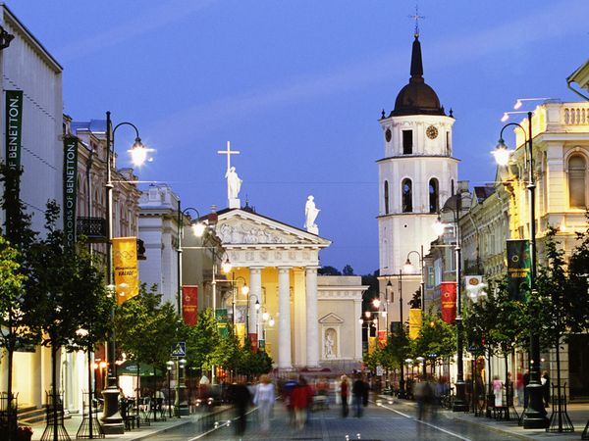
Part I. Lithuania Today
Notes:
Reconstructed Vilnius – main street & cathedral.

Slide 4
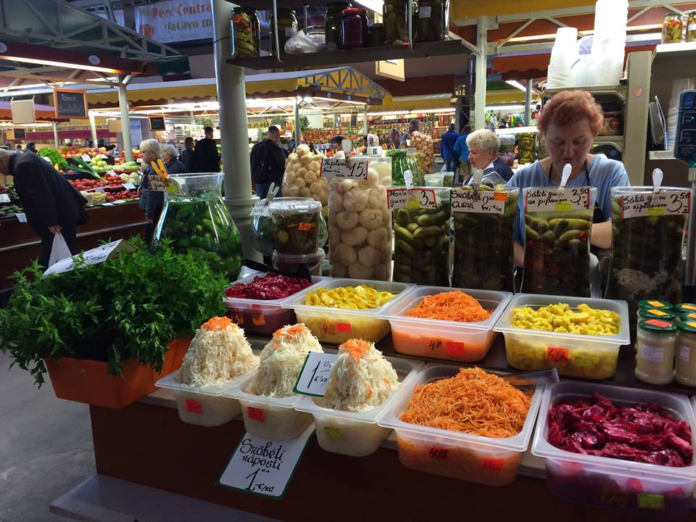
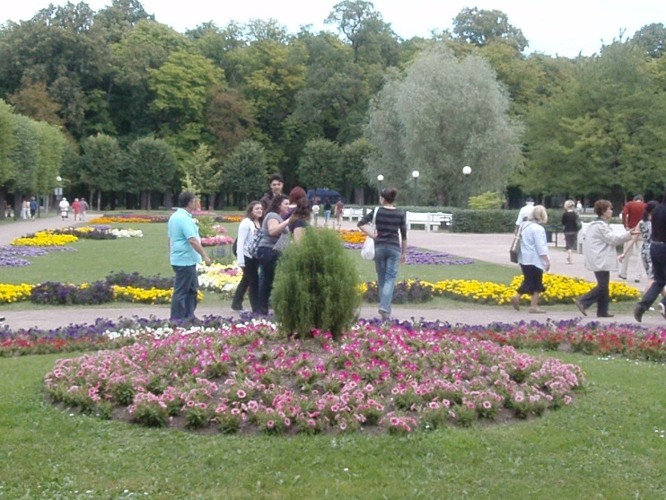
Riga, Latvia
Central Market
Vilnius, Lithuania
Cathedral Square
Tallinn, Estonia
Catherine I’s Garden

Slide 5
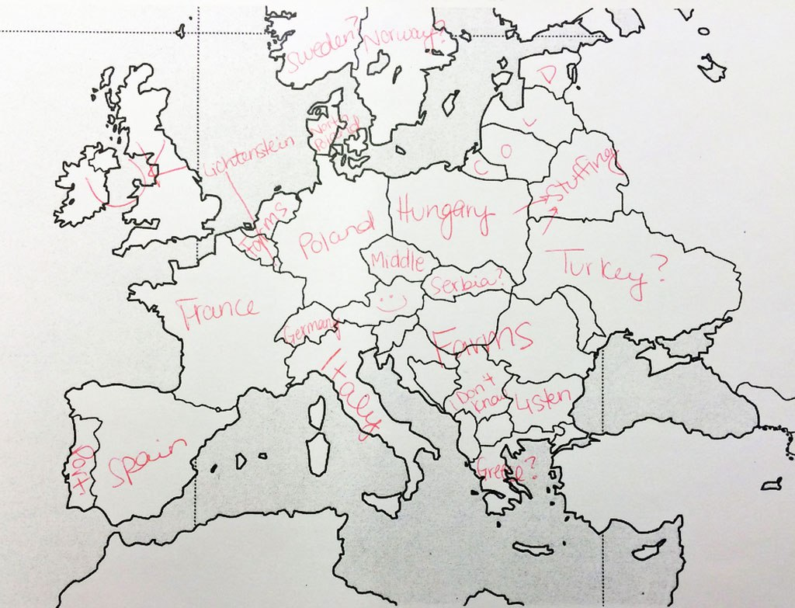
American college students – geography quiz
Where is it?
Lithuania
Latvia
Estonia
http://twistedsifter.com/2014/01/americans-and-brits-label-maps-of-europe-and-us/

Slide 6
From Worldatlas Online
Three Baltic States: Lithuania, Latvia, Estonia

Slide 7
Friendly Neighbors
Finland
Estonia
Latvia
Poland
Sweden
Wary Neighbors
Russia
Kaliningrad
Belarus

Slide 8
Belarus:
Fortified border
Unsafe nuclear power plant

Slide 9
Kaliningrad: Russian access to its Baltic Fleet

Slide 10
What’s at Stake?
3 New democracies after Soviet occupation
Joined NATO & EU (2004) – defense
Joined Euro Zone (2015) – free trade
Shared Gazprom-free power supply
“LitGrid”
“NordBalt” and “LitPol” power cables
LNG vessel in Baltic Sea

Slide 11
Baltic Concerns
Russian mobile missiles in Kaliningrad
2 Russian warships sent to Baltic Sea
Isolationism threatens national security
Will Brexit weaken NATO?
Ukraine…will Baltics be next?

Slide 12
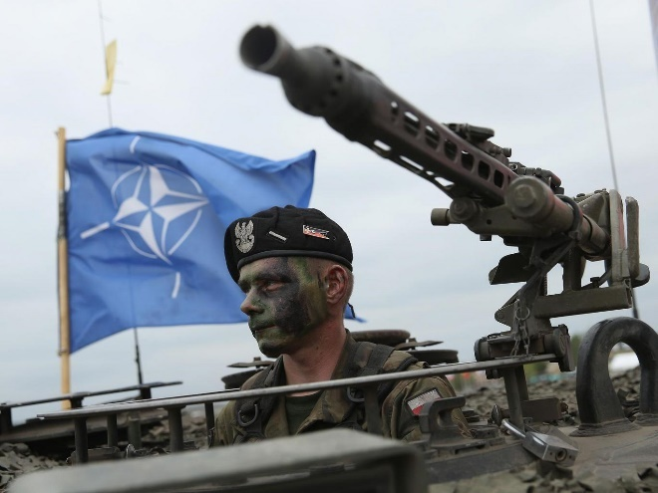
Russia’s Concerns
Maintain land access to Russian Fleet HQ
Diminished oil revenue from Eastern Europe
American Special Forces = “worrisome”
NATO Force Integration Units (NFIU’s)

Slide 13
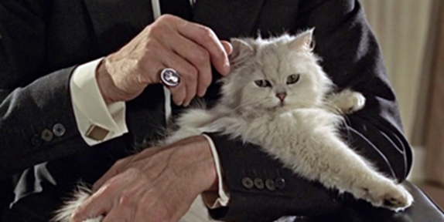
Lithuania’s Concerns
Shared energy supply – vulnerable
Baltic trade – crucial for economy
Russian hacking & propaganda
Russian troop buildup along eastern border

Slide 14
What’s happening NOW
Russian aircraft intercept NATO jets (110 incidents in 2016)
11-nation NATO “Iron Sword” drills in Lithuania (3500-4000 troops, 2016)
Germany sends infantry & equipment (2017)
Sweden and Finland drawing closer to NATO
Growing unrest in Ukraine

Slide 15
Who will take the next step?

Slide 16
Lithuanian President Dalia Grybauskaitė – “The Iron Lady”

Slide 17
Jens Stoltenberg – NATO Secretary-General

Slide 18
NATO: “Take 2% guideline seriously!”
% GDP (2016)
Estonia 2.16%
Poland 2.00%
Lithuania 1.49%
Latvia 1.45%

Slide 19
Will President Trump Support NATO?

Slide 20
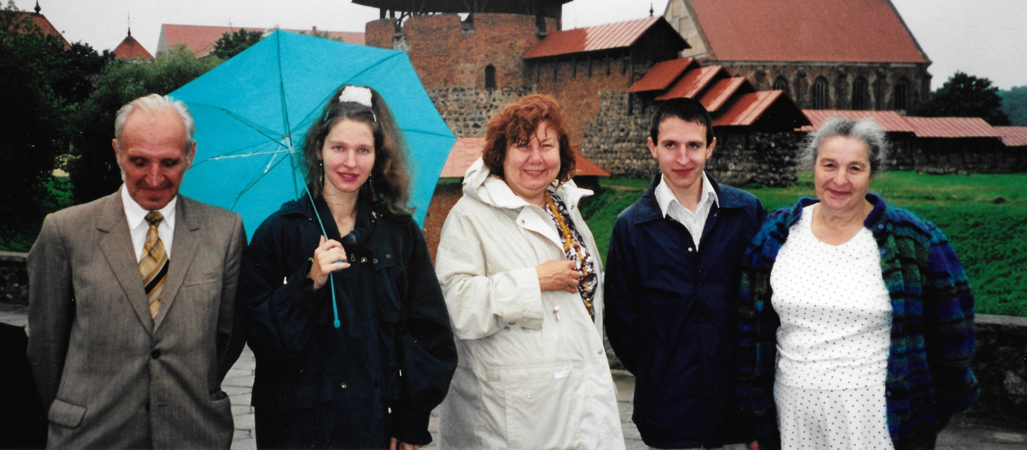
Why do I care?
I still have relatives there, and they’re worried.

Slide 21
Why Should We Care?
WE are in NATO, that’s why.
Russian view: “NATO is an offensive agreement trying to hem us in on all sides”
Lithuanian view: “NATO is a defensive agreement to protect our freedom”

Slide 22
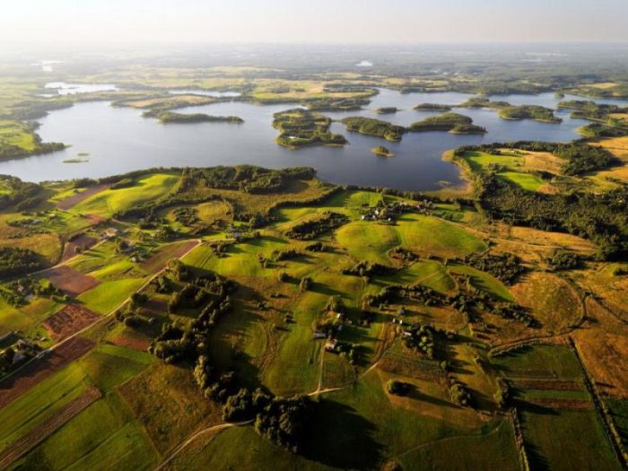
Part II. The Land and its People
Notes:
Locations – next slides.

Slide 23
The Land
Lithuania = small country: 25,000 square miles (1/4 area of Colorado; size of W. VA.)
Lowland terrain, fertile soil, Neolithic mounds
Traditional agricultural economy
Tiny seacoast, single river system
No natural borders

Slide 24
Lithuania and USA Comparison

Slide 26
Tiny Seacoast (56 miles)
Landlocked except for Klaipeda seaport
Palanga – airport, historic Amber Museum
Curonian Spit (National Park) protects harbor, port cities, and fragile coastal ecosystems

Slide 27
Palanga –
airport
Klaipeda –
seaport
Curonian Spit

Slide 28
61 Mile Sand Bar (Curonian Spit)
UNESCO World Heritage Site
Lithuania & Kaliningrad each have a national park here

Slide 29
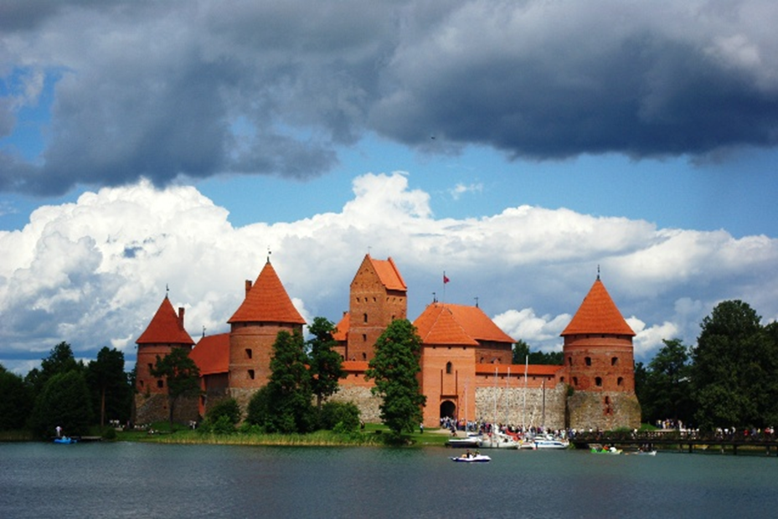
Nemunas/Neris River System
Connects the capital cities
Main trade route from Vilnius to the sea

Slide 30
Kaunas (oldest city)
Vilnius (Current capital)

Slide 31
Kaunas (Oldest city; Capital under Soviet Rule)

Slide 32
Vilnius (Capital since 1253; Parliamentary Palace)
Notes:
I invite you to see maps in the back of the room and I will answer your questions.
THE END

Slide 33
The People
Lithuanian Population – 3 million (~ Denver)
Ethnicity – 84% Lithuanian, 7% Polish, 6% Russian
Religion – 77% Roman Catholic, 4% Russian Orthodox, some Jews since 14th Century
Occupations – services, industry, agriculture
“Brain Drain” to western Europe

Slide 34
Economy
Farms: private ownership
Forests, fields, bees: communal ownership
Traditional exports: agricultural products, amber, linens
Current exports: machinery, plastics, chemicals (Industrialization by USSR)
GDP ~$80 billion (cf. Denver ~$187 billion)

Slide 35
Agricultural Products
Notes:
Christmas treats!

Slide 36
Amber and Linens
Notes:
Traditional trade goods

Slide 37
Languages
Lithuania – 82% Lithuanian, 8% Polish, 6% Russian
Latvia – 61% Latvian, 26% Russian, 10% unspecified
Estonia – 69% Estonian, 30% Russian
English – Taught in schools, language of the Internet and international conferences

Slide 38
Russian (Slavic)
Lithuanian & Latvian (Baltic)
Polish (Slavic)
Estonian (Finno-Ugric)

Slide 39
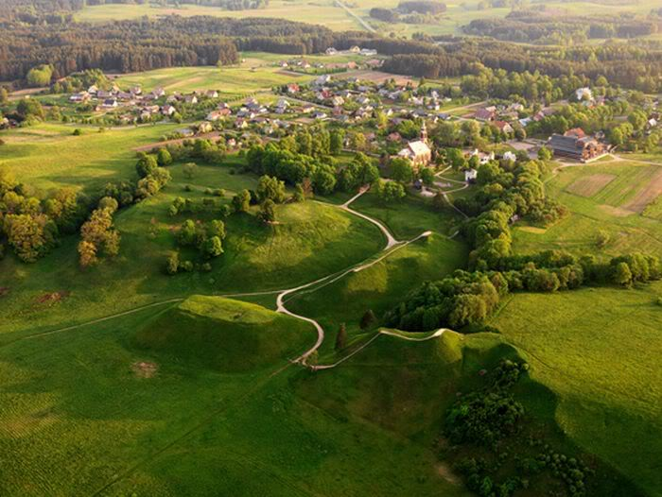
Part III. History: A Play in 5 Acts

Slide 40
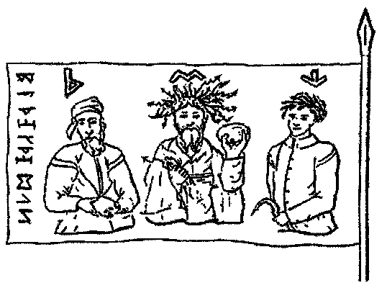
Act 1: “The Good Old Days”
Cartoon of tribal leaders

Slide 41
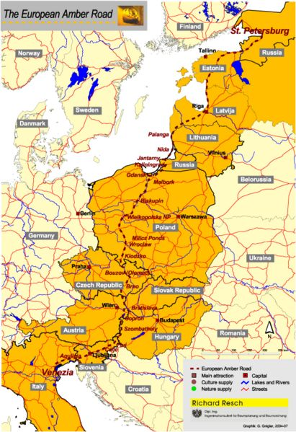
Ancient Amber Trade Route
Amber found near Palanga (Jūratė legend)
Valuable trade resource (fossilized tree resin)
Trade routes led to fixed settlements

Slide 42
Amber Room (St. Petersburg)

Slide 43
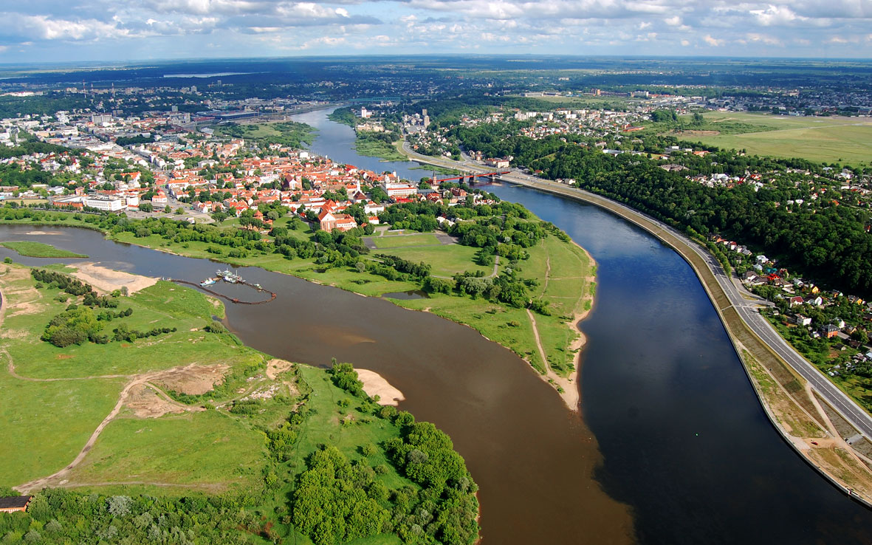
Baltic Settlements
Kaunas founded by Romans (really??)
Balts settled along River confluence

Slide 44
Slavic Migrations ~500-700
swamps
Slavic Origin Unknown

Slide 45
Viking River Trade ~800
Two river routes to trade with Constantinople
Northern trade route – From Gulf of Finland -> Novgorod & Kiev -> Dnieper River -> Black Sea
Southern trade route – From Baltic Sea -> Vistula & Dniester Rivers, via Poland, Ukraine & Moldova -> Black Sea

Slide 46
Viking River Routes
Notes:
Both routes bypass Lithuania. Why??
Lithuania’s Nemunas River is navigable for about 560 miles.
Because it originates in the eastern highland swamps of Belarus and empties into the Baltic Sea to the west, it was of no use for Viking trade.
But Lithuania’s southern and eastern neighbors were settled by the Vikings.

Slide 47
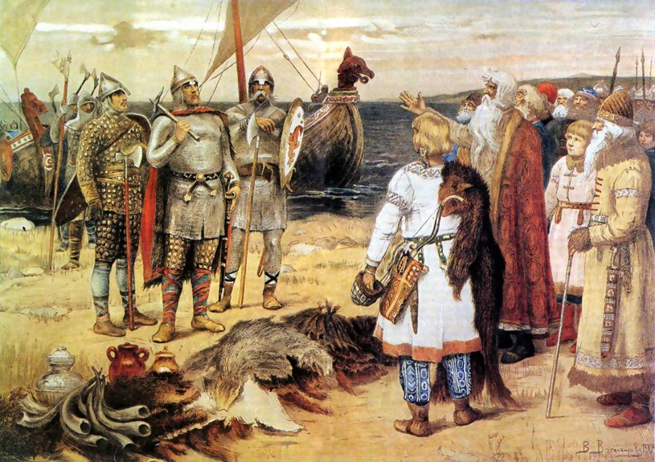
Vikings settled in Russia ~800-900
Prince Rurik & his Vikings settled in earlier river towns, subjugated the local Slavs

Slide 48
Kievan Rus’ ~800-1250
Prince Vladimir of Kiev (988)
Needed a religion to hold the state together
Married Anna, sister of Byzantine Emperor, Basil II
Declared Orthodox Christianity state religion
Kiev flourished with Dnieper River trade
Moscow (founded 1144), little town in Vladimir Suzdal, gained power in 1300s

Slide 49
Russia in 1237
Novgorod
No Lithuania yet
Vladimir-Suzdal
Kiev

Slide 50
Poland ~900-1385
Polonia tribal leader Mieszko married Bohemian Princess Dobrava (966)
Declared Catholicism state religion
Defensive alliance with Holy Roman Empire
His son son Boleslaw crowned King of Poland
Boleslaw founded the Piast Dynasty (992)

Slide 51
Polish Piast Dynasty
Piast Dynasty lasted 400 years
Polish kings welcomed the Jews fleeing from German pogroms (1300s)
King Boleslaw
Commemorative coin

Slide 52
The Northern Crusades
Hospitalers (1048) and Templars (1119) founded “…to protect the pilgrims”
Teutonic Knights – German Crusaders
Founded a hospital in Acre (near Haifa Bay);
Disbanded after Acre fell
Moved to Marienburg
Subjugated the Old Prussians

Slide 53
Teutonic Knights and Kaliningrad
Teutonic Knights built the Port of Memel on the Baltic Sea (now Klaipeda)
Founded Königsberg (1252-55)
Prussian cultural center (1500s)
Destroyed by the Red Army in WWII,
Ruins given to Russia in 1945 (Potsdam Agreement), renamed “Kaliningrad Oblast”
Ethnic cleansing, now Russian-speaking

Slide 54
Prussia After the Crusades
Port of Memel
Samogitia
Marienburg on the Vistula
Sanson, plate 1752, Danzig Königsberg…

Slide 55
The Hanseatic League
Rise of northern European merchant class in Lubeck, Hamburg, and Bruges
Codified German maritime laws
Cleared the Baltic Sea of pirates
Monopolized Baltic trade and fishing
Spread to Livonia (= Latvia & Estonia)

Slide 56
The “Age of Faith”
Russian Orthodox: Kievan Rus’ (988), Muscovy Christianized later
Catholic: Prussia, Livonia (subjugated by Teutonic Knights), and Kingdom of Poland
Pagan: Lithuania – Baltic tribes began to form Duchies (mid-1200’s)

Slide 57
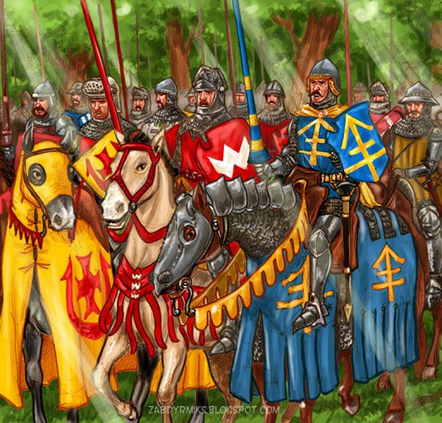
Act 2: “Battles & Boundaries”

Slide 58
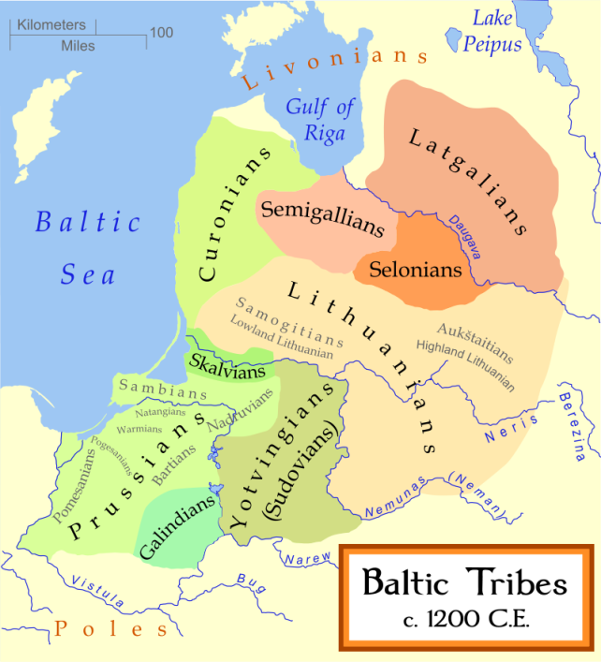
Birth of Lithuania ~900-1200
Livonia
Duchy of Courland
Samogitia
Kaunas
Future site of Vilnius
Old Prussians

Slide 59
Lithuania ~1200-1569
Baltic Dukes united by language & culture
Elected a Grand Duke (“first among equals”)
Rural agricultural economy and traditions
Song, dance, handicrafts, foods, beer, & pagan customs were important (and still are!)

Slide 60
Kucios: Winter Solstice

Slide 61
Rasos: Summer Solstice

Slide 62
Livonia (~1200-1558)
Bishop Albert of Riga (Latvia) founded the Livonian Order of the Sword (1202)
Allied with Teutonic Knights (1237)
Bishops lost control of the northern Crusaders
Tried to convert the Curonians & Samogitians
Pillaged, looted and burned Lithuanian villages

Slide 63
Livonia & Baltic States in 1260
Livonian Order
Duchy of Courland
Livonia = Latvia & Estonia
Samogitia
Riga
F. De Wit
(1629-1706)
Map c. 1680
Lithuanians
Notes:
De Wit map ~1680 Amsterdam

Slide 64
Battle of Durbe (1260)
Lithuania split the Northern Crusaders, won Baltic seaport & coastline
Livonian Order
Lithuanians
Teutonic Knights

Slide 65
The Only King of Lithuania
King Mindaugas Commemorative silver coin

Slide 66
King Mindaugas (1253-1263)
Dukes elected Mindaugas Grand Duke (1236)
Became Catholic and was crowned King
Built a new capital & cathedral at Vilnius
Tried to convert the pagans
Made a peace treaty with Livonia (oops…)

Slide 67
King defied cultural norms…
Mindaugas & son both assassinated! (1263)
No forced conversions!
No treaties with our enemies!
No hereditary monarchies!
Lithuania reverted back to a grand duchy.

Slide 68
Meanwhile, in Russia… (Film by Sergei Eisenstein, 1938)

Slide 69
Teutonic Knights invade Novgorod
Novgorod hired Alexander “Nevskii,” Grand Prince of Kiev & Vladimir
Won the “Battle of the Ice” (1242)
Moved to Novgorod
Established new center of Rus’ power
Rus’ power waned in Kiev
Mongols saw Kiev’s weakness

Slide 70
Mongol invasions from Sarai
The “Golden Horde” destroyed Kiev (1240)
The Khans demanded tribute
Kievan Rus’ Princes sought Lithuania’s aid
In return, Rus’ Princes ceded Polotsk and Smolensk to Lithuania
Lithuania grew more powerful
Later on, Mongol power declined in Russia

Slide 71
Mongols attack Rus’ from Sarai (1240)
Note: Lithuania is off this map

Slide 72
Lithuania gains Rus’ lands (1240)
Polotsk, Smolensk
Lithuania

Slide 73
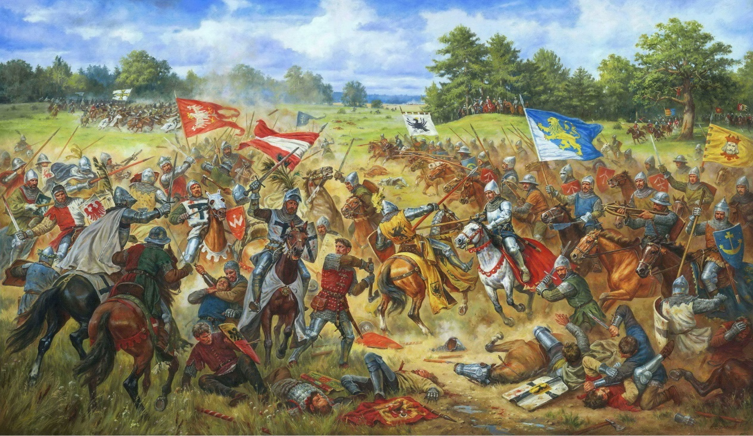
Act 3: “Growing Pains”

Slide 74
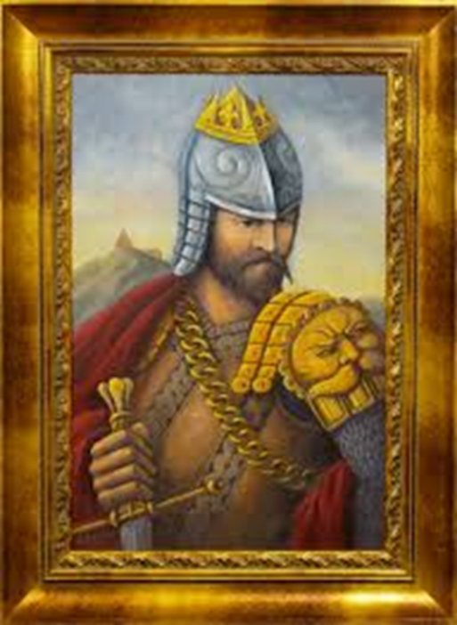
Grand Duke Gediminas (1316)
New ruler, new dynasty (1316-1341)
Made strong trade alliances
Married his children to other rulers
Invited more Jews to Lithuania
Enforced freedom of religion
Gained more Rus’ lands

Slide 75
Lands gained by Gediminas Lands gained by his sons Algirdas and Kestutis Need allies? “Go West, young man!”

Slide 76
Marriage Alliance (1385)
Algirdas’ son, Grand Duke Jogaila (pagan, age 26) proposed marriage to Polish Queen Jadwiga (Catholic, age 11, last of the Piast dynasty)

Slide 77
The Marriage Contract (1385)
Jogaila was baptized Władysław Jagiełło
Crowned King of Poland by the Pope
Tried to convert the Lithuanians
Left his throne in Vilnius
Moved to Krakow to co-rule with Jadwiga
Separate countries, 2 separate armies
Dukes envied Polish nobles (Polonization)

Slide 78
Lithuania & Poland in 1387
Vilnius
Krakow (Capitol)
Kiev

Slide 79
A House Divided…
Queen Jadwiga died in childbirth (1399)
King Jogaila remarried much later, stayed in Poland, founded Jagiełłonian dynasty
Duke Vytautas of Trakai (his cousin) was elected Grand Duke of Lithuania, equal in power & prestige to King Jogaila

Slide 80
“Game of Thrones”
“Ten dervishes can sleep on one rug, but two kings cannot be accommodated in an entire kingdom.”
(Persian proverb)

Slide 81
Vytautis “The Great” (1392-1430)
Defeated the Teutonic Knights (Battle of Grunwald, 1410)
Became a national hero!
Died childless in 1430, so his lands & power reverted to Jogaila’s heirs

Slide 82
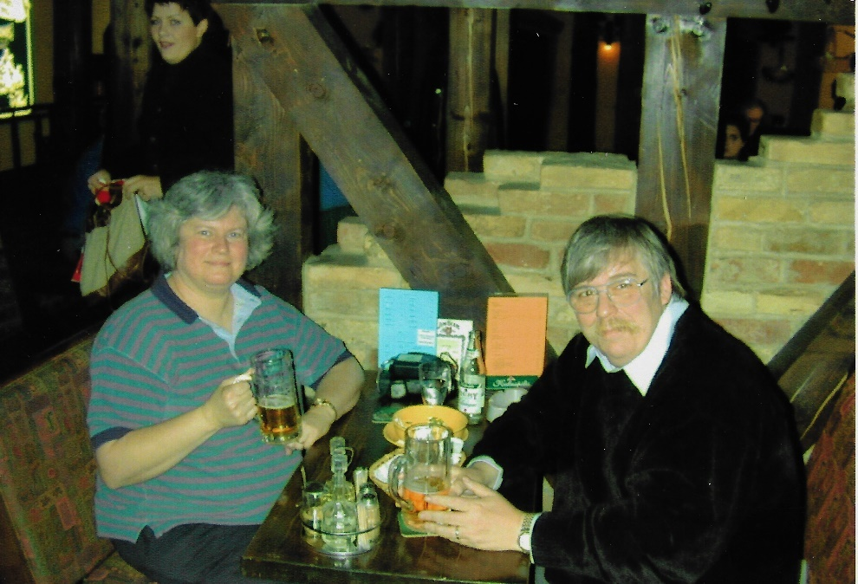
Vytautis’ Castle at Trakai

Slide 83
Vytautas expanded Lithuania from the Baltic Sea to the Black Sea Too big to govern!

Slide 84
Livonia declined; Moscow grew strong
Teutonic Knights – strong armies, weak rulers
Semi-independent Hanseatic League cities carried on prosperous Baltic trade
Protestant Reformation -> political chaos!
Livonia ruled by Russia, Poland, Sweden
Peter The Great conquered Livonia (1710)
Occupied by Russia until 1918

Slide 85
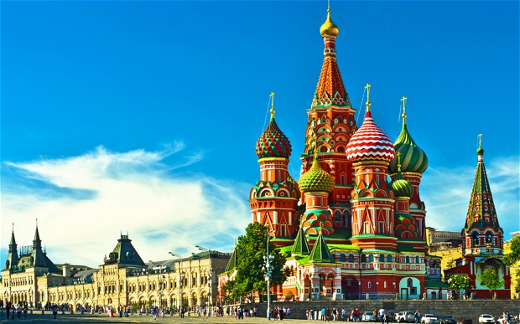
Act 4: “Jockeying for power”
St. Basil’s Church in Red Square

Slide 86
Moscow & Lithuania ~1462
Novgorod
Tver
Pskov
Vladimir
Annexed by Lithuania
Moscow
Smolensk

Slide 87
The Muscovites (1462-1696)
Fall of Constantinople (1453)
Grand Prince Ivan III of Moscow (1440-1505)
Annexed Tver, “Gathered Russian Lands”
Married Byzantine Princess Zoe (Sophia) in 1472 gained her title and privileges
Declared himself Tsar (Russian for “Caesar”)
Freed Moscow from the Mongols (1480)

Slide 88
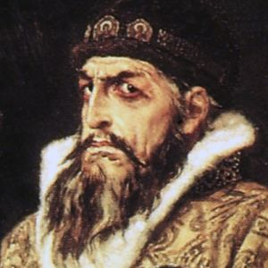
Tsar Ivan IV “The Terrible”
Tsar Ivan IV subjugated Novgorod, moved Ruriks out, moved Muscovites in (1570s)
Moscow gained wealth & a strong army
Wanted Lithuanian-controlled Rus’ lands
Lithuania needed an ally
Looked west…
Tsar Ivan IV, 1533-1584

Slide 89
Lithuanian-Italian Alliance (1518)
King Sigismund I “The Old” married Bona Sforza, niece of Holy Roman Emperor Maximilian I
A rebellious son and 3 daughters…
Church of Sts. Peter & Paul, Vilnius

Slide 90
“I read it in the tabloids…”
Crown Prince Sigismund II –
Scandalous affair with Barbora Radziwiłł
Her brother arranged the secret marriage (1547)
King Sigismund “The Old” died (1548)
Sigismund II crowned king, legalized his marriage
Barbora died 5 months later (no heir to throne)
Tsar Ivan IV saw his chance for a “land grab.”

Slide 91
Game of Thrones?

Slide 92
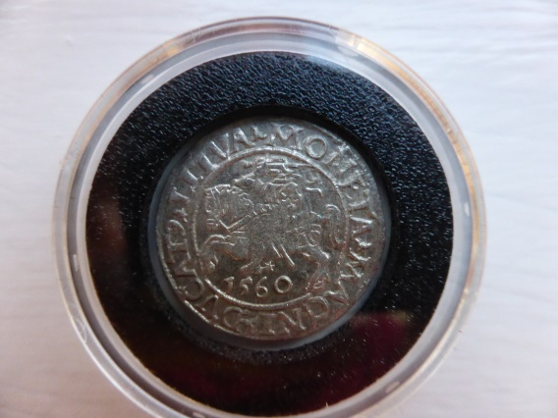
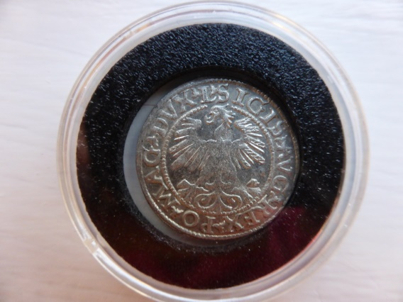
Treaty of Lublin (1569)
Tsar Ivan IV forced King Sigismund II to sign a treaty creating Polish-Lithuanian Commonwealth (2 nations, 1 king)
Coin from King Sigismund II’s realm

Slide 93
End of Jagiellonian Dynasty
King Sigismund Augustus II died (1572)
Bona moved back to Italy, poisoned & died.
Her daughter Anna -> Queen of Poland (no kids)
Her daughter Isabella -> Queen of Hungary
Her daughter Catherine -> Queen of Sweden
No clear Polish-Lithuanian succession…

Slide 94
Dividing the Spoils…
West:
Polish Dukes elected European royals as kings
European royals meddled in Polish politics
East:
Ivan IV “The Terrible” died, Rurik dynasty ended
Michael Romanov elected Tsar (1613)
Lithuania was caught in the middle!
Borders kept shifting…

Slide 95
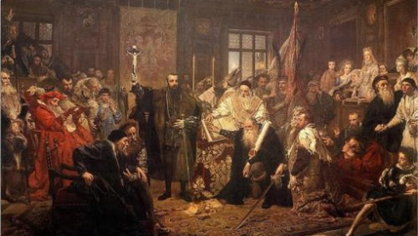
Act 5: Lithuania “on & off the map”
Union of Lublin image from Rightbankwarsaw.com

Slide 96
Bigger Empires – Better Maps
Bernard Wapowski (1450-1535) – close friend of Copernicus, first map of Poland-Lithuania
Lithuanian King Stephen Batory (Anna’s husband) founded Vilnius University (1579)
Geography and cartography were taught there
Attracted European cartographers
Vilnius shown on historic maps

Slide 97
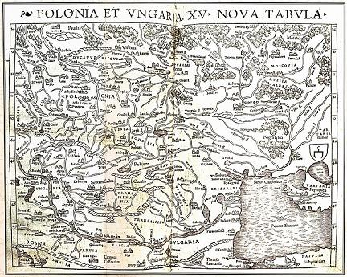
Wapowski – Poland
Vilnius
1528 woodcut attributed to Bernard Wapowski (1450-1535)
in the archives of King Sigismund Augustus I

Slide 98
Mercator – Lithuania
Vilnius
Gerard Mercator
(1512-1594)
print in 1595 Atlas uses new projection

Slide 99
Radziwiłł Map (1613)
Vilnius
Joan Blaeu, 1596-1673, print in 1630 Atlas; original wall map is in Sweden

Slide 100
Willem Blaeu – Russia
Vilnius
Willem Blaeu
(1571-1638)
Inset of Moscow
by Braun & Hogenberg

Slide 101
John Speed – Russia
Vilnius
John Speed
(1551/2-1629)
Print in 1626; Prospect (atlas) 1676 edition

Slide 102
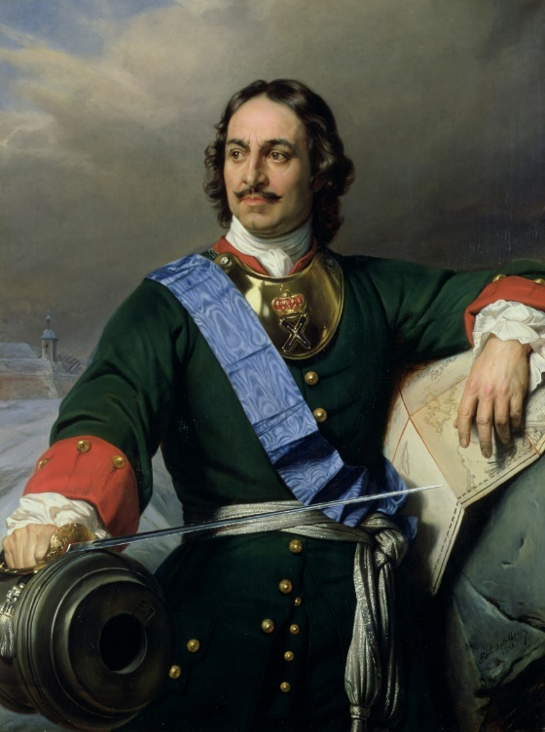
“Gathering more Rus’ lands”
Tsar Alexis Romanov supported Orthodox Cossack uprising against Catholic Lithuania (1649)
Tsar Peter I the Great regained Smolensk & Kiev (1649-1686)
Tsar Peter I invaded Livonia (1710)

Slide 103
Poland-Lithuania in 1660
Courland
Samogitia
Vilnius
Smolensk
Kiev

Slide 104
Decline of Poland-Lithuania
Class and language divisions
Bribery and corruption
Augustus II of Saxony annexed Lithuania (1697)
Prussia & Austria fought to get parts of Poland
Poland asked Russia for protection (like asking the fox to guard the henhouse!)

Slide 105
Clouet – Prussia & Lithuania
Klaipeda
East Prussia
Vilnius
Belarus
Jean Clouet
(1729-1790)
“School Map”
Printed 1767

Slide 106
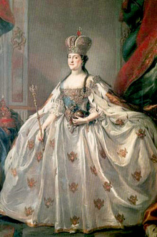
First “Partition” of Poland 1772
Catherine the Great
Feared overthrow of monarchies by republics
Had Stanislaw Poniatowski elected King of Poland (1764)
Annexed parts of Ukraine and Belarus

Slide 107
Occupation and Uprisings
Nobles rejected democratic reforms
Parliament was split!
French Revolution inspired civil war (1793)
Kościuszko’s uprising was crushed (1794)
Russia overthrew the government
Poland-Lithuania partitioned (50 provinces)

Slide 108
Treaty of Versailles 1795
19th century British cartoon in Lithuanian Heritage Magazine

Slide 109
Partitions of Lithuania-Poland (Lithuanian Heritage, Jan/Feb 2014)

Slide 110
Second and Third “Partitions”
Treaty of Versailles (1795)
Russia got Lithuania and its old Rus’ lands
Prussia got East Prussia (Königsberg to Kaunas)
Austria got the Lublin-Krakow area
Lithuania was wiped off the map!
But this is not the end of the play…

Slide 111
Part IV. Finale!

Slide 112
Russian Oppression (1795-1918)
Lithuanian officers joined Napoleon (1790s - 1812) but were defeated
Nobles were exiled, their lands confiscated
Roman alphabet & Lithuanian language forbidden
Catholic Church supported independence movements
“Window of freedom” between WWI-WW2

Slide 113
Soviet Oppression (1940-1989)
Emigrations to USA (1861-1921, 1941-1967)
June 14, 1941: ~130,000 Lithuanians were deported to Siberia (> 70% women & children)
Starvation, “slave labor” under Communism
Why? “Patriotism challenged Soviet system.”

Slide 114
Baltic Freedom Movement (1989) “Sajudis” – 3 Baltic States join hands

Slide 115
The Path to Independence
1795-1918 – Occupations & uprisings
1918 – WWI ends, short independence
1940 – WWII, Soviet Army invades
1989 – Baltic Freedom Movement (“Sajudis”)
1991 – USSR falls, independence referendums
2004 – Baltic States join NATO and EU
2008 – Economic crisis & inflation
2015 – On the Euro, energy independence

Slide 116
Celebrating Independence (2017)

Slide 117
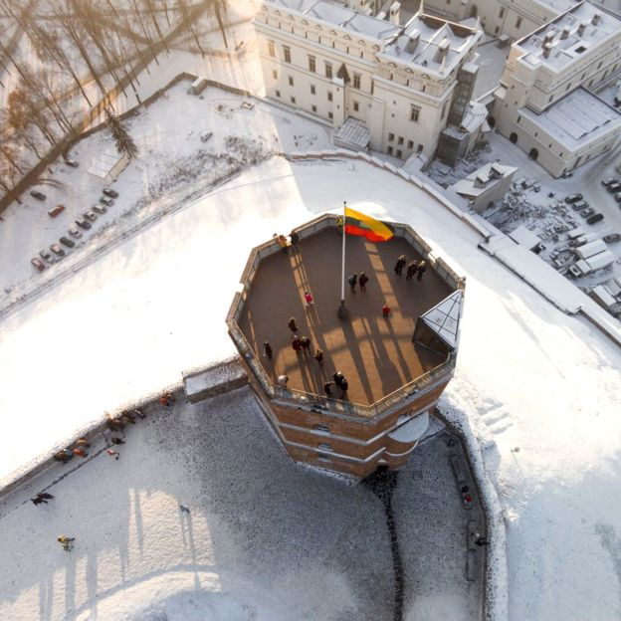
“It’s hard to keep a good country down!”
That’s all, folks.
Please look at the maps.
Ask questions.
Drone view of Vilnius

